Slide 1

Events In JavaScript
M.Latif

Slide 2
Introduction
Events are the actions that occur in the browser. They are the actions that the user performs on the browser.
Events are also the actions performed on HTML elements by the user. For example, when the user clicks on a link, the browser sends an event to the server. The server can then take some action based on the event. For example, the server can send a message to the user.

Slide 3
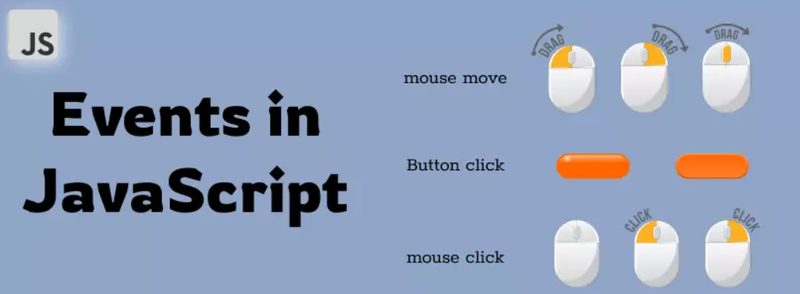
Some of the simple examples of events are:
Button click
Mouse click
Keyboard input
Form submission
Page load
Window resize

Slide 4
Handling events in javascript
Each event in javascript has something that is constantly looking for that event to occur which is called event listener.
The event listener triggers a function execution whenever the event occurs

Slide 5
Add Event Listener
There are 2 ways to add an event listener to an element in javascript:
Using the addEventListener() method.
Using the on attribute. for example onclick, onmouseover, etc.

Slide 6
1. Using the addEventListener() method
The addEventListener() method is used to add an event listener to an element. The addEventListener() method takes 2 arguments:
event - The event that is being listened for.
listener - The function that is called when the event occurs.

Slide 7
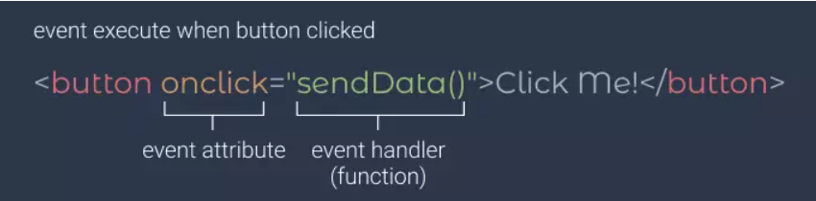
2. Using The On Attribute
Using the on attribute method you can directly add an event listener to the HTML element. Examples of attributes are onclick, onmouseover, etc.

Slide 8
Remove Event Listener
To remove an event listener from an element, you can use the removeEventListener() method. The removeEventListener() method takes 2 arguments, event and listener.

Slide 9

Types Of Events In Javascript

Slide 10

Timeline
1st
2nd
3rd
4th
5th
6th
7th
8th
Window Events
Mouse Events
Keyboard Events
Form Events
Storage Events
Media Events
Drag Events
Clipboard Events

Slide 11
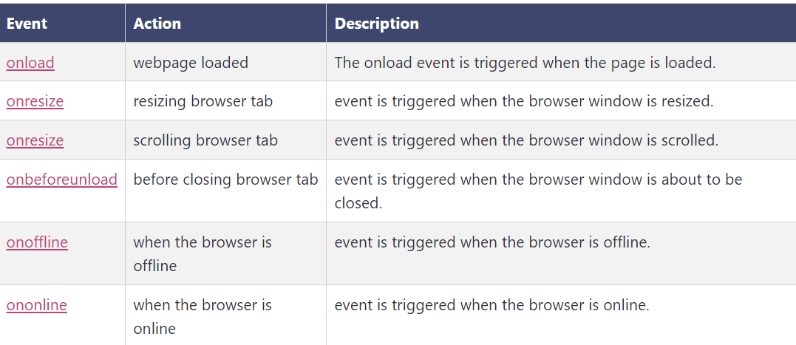
1. Window events in javascript
The window object is the top-level object in the browser. It is the parent of all other objects in the browser. Bellow few events.

Slide 12
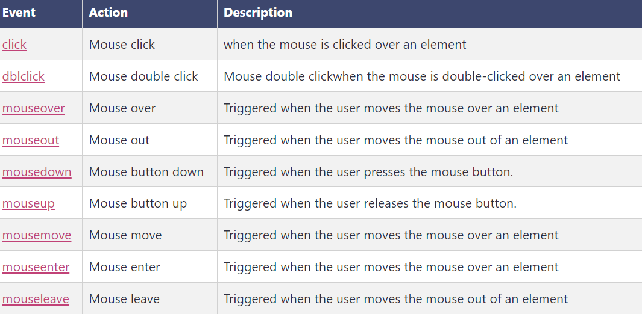
2. Mouse events in javascript
Mouse events are those events that are triggered on some activity by the mouse, like clicking, hovering, dragging, etc.

Slide 13
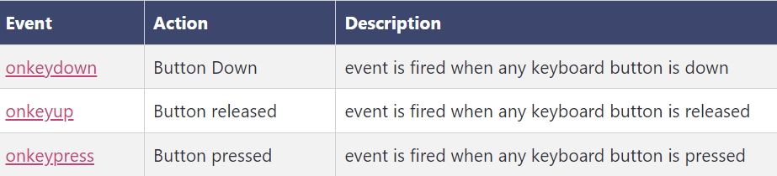
3. Keyboard events in javascript
Keyboard events are those events that are triggered when you press a key on your keyboard.
There are many different types of keyboard events in javascript. Some of them are:

Slide 14
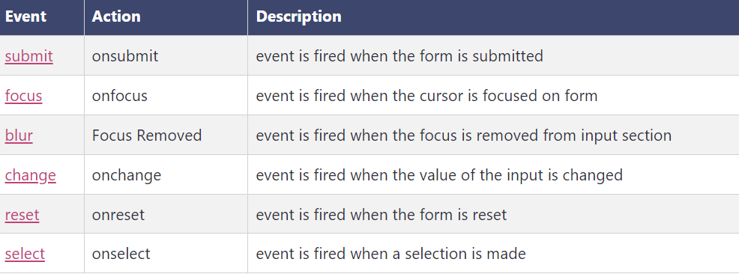
4. Form events in javascript
Forms in HTML have many different types of events that can be triggered at different action points.
The form events in javascript are:

Slide 15
5. Storage Event in JavaScript
The Storage Event is triggered when the storage area is changed.

Slide 16
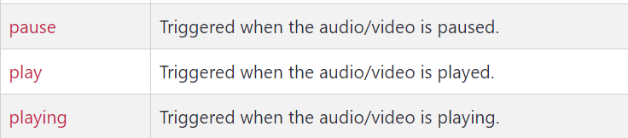
6. Media Events in JavaScript
Media events are events that are triggered by media elements. These events are triggered when different actions are taken or occur on the media element.

Slide 17
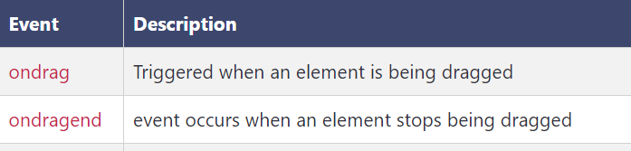
7. Drag Events in JavaScript
Drag events are events that are triggered by drag and drop actions.

Slide 18

Thank you
Muhammad latif
kharmangi129@gmail.com

